Slide 1
Evidential Deep Learning: Enhancing Predictive Uncertainty Estimation for Earth System Science Applications
Schreck et al. 2024
Machine Learning Journal Club
November 19, 2024
Notes:
Note:
Significance
Uncerstainty decomposition: Stochastic and Systematic
UQ:
Cost -> Ensembles
No calibration
Mush everything together
Aleatoric Uncertainty, reduce by adding better predictors, to better describe the prediction within one model.
Epistemic Uncertainty, reduce by more data, reduce the variance between each trained model
Example
Winter Precip Type Classification
4 labels
Not enough occurrences and hard to predict and classify the sleet and frozen rain -> Alea
Method
ENN, See Fig 2a
New Loss Function
New Last Layer
Still using gradient decent, but output distribution
Can be Discrete or Continuous?
See Fig 1c, good stuff
Result
Fig 3(?)
Fig 4
Fig 5
Fig 6

Slide 2
Introduction: Uncertainty Quantification
Ensemble Forecast
Physics-Based Model
Change Initial Condition, Boundary conditions, Model Specifications
High computational cost
No uncertainty calibration
Machine Learning Model
Cross Validation → Vary in data split
Deep Ensemble → Vary in weight initialization
Monte Carlo Dropout → Randomly deactivate weights, or using dropout layer
Still expensive
Evidential Deep Learning

Slide 3
Motivation - Aleatoric and Epistemic Uncertainty
Consider two extreme cases:
Unpredictable output data (Aleatoric)
Noisy input data (Epistemic)
ML Ensemble Result:
Unpredictable output
→ Unreliable predictions for all models
→ Large spread in ensemble result
Noisy input
→ Each subset captures different dynamics
→ Every model makes different predictions
→ Large spread in ensemble result
Input | 3 | 4 | 3 | 4 | 3 | 4 | 3 | 4
Output | 1 | 2 | 3 | 4 | 5 | 6 | 7 | 8
Input | 1 | 2 | 3 | 4 | 5 | 6 | 7 | 8
Output | 3 | 4 | 3 | 4 | 3 | 4 | 3 | 4

Slide 4


Aleatoric and Epistemic Uncertainty
Aleatoric Uncertainty
a.k.a. Stochastic Uncertainty, unexplained component, EV, etc.
We cannot make accurate predictions with the input. The output "seems" stochastic with the given input.
Epistemic Uncertainty
a.k.a. Systematic Uncertainty, explained component, VE, etc.
The input data is noisy, or some mislabelled samples (thus, systematic), so the model trained by those data cannot make accurate predictions.
Notes:
Science humor, eve’s law just means EVVE <- total variance. Then we must have adam’s law, so renaming total expectation.

Slide 5

Solution - Uncertainty Examples
Consider two extreme cases:
Unpredictable output data (Aleatoric)
Noisy input data (Epistemic)
How to improve model
Technically, we cannot remedy this problem
Add other input that better describes the output
Gather model data to make training independent from training split
Reduce model complexity(?), so less overfitting
X: Training Process: data noise, model config…
Y: Model Output: Y = f(input)
Input | 3 | 4 | 3 | 4 | 3 | 4 | 3 | 4
Output | 1 | 2 | 3 | 4 | 5 | 6 | 7 | 8
Input | 1 | 2 | 3 | 4 | 5 | 6 | 7 | 8
Output | 3 | 4 | 3 | 4 | 3 | 4 | 3 | 4
Aleatoric Epistemic

Slide 6
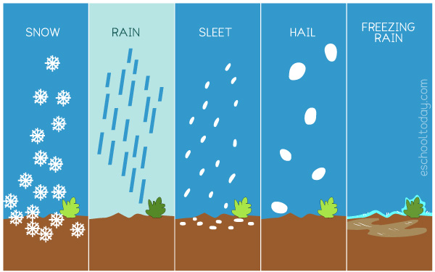
Precipitation Type Prediction Example
Input: 4 meteorological variables (T, Td, u, v)
Output: Rain, Frozen Rain, Sleet, Snow
Problem: Inconsistent precipitation data
- The data and report are crowd-sourced reports. The outcome may vary due to subscale meteorological and societal factors
- Mislabelled sleet and freezing rain
- Small Occurrences: sleet and freezing rain
Therefore, we have probabilistic result for each label (multinomial distr.)

Slide 7
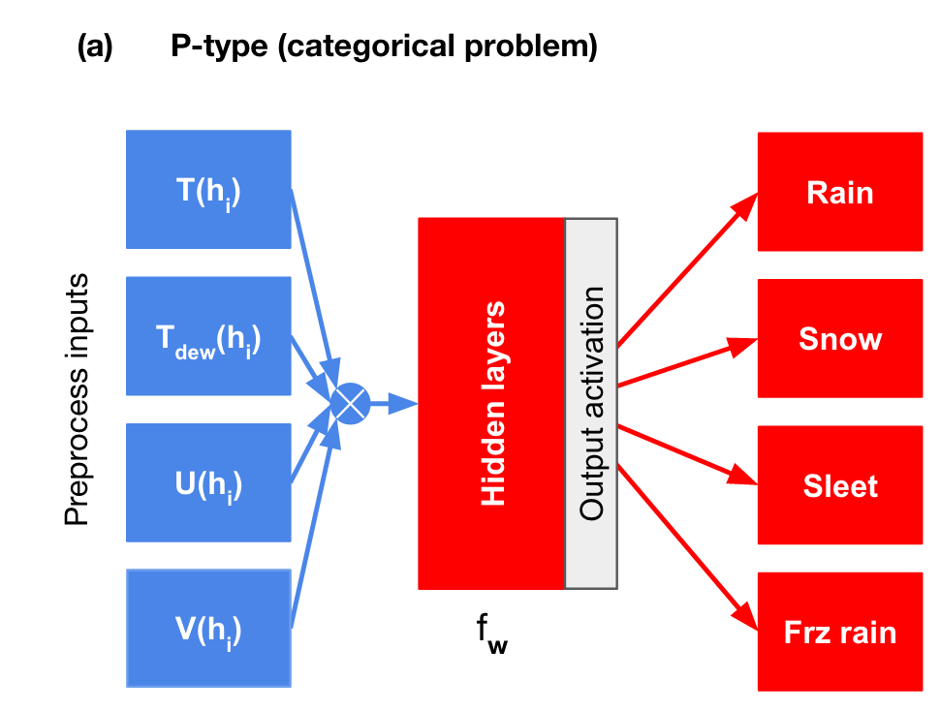
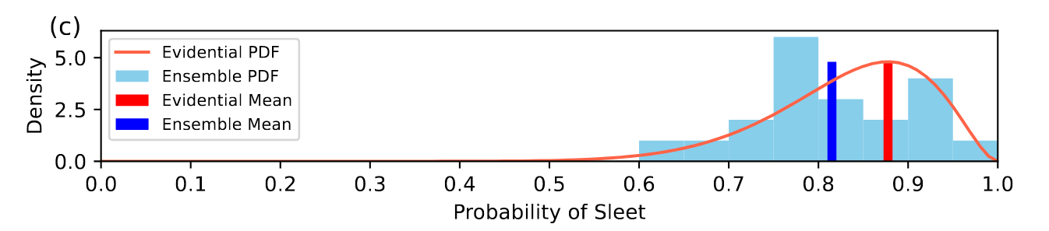
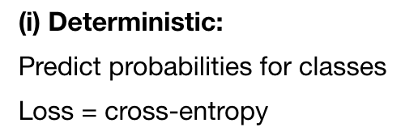
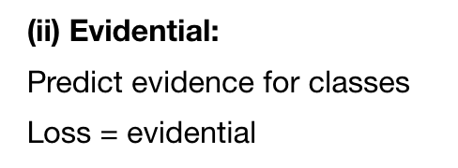
Evidential Neural Network
Traditional NN
Loss: cross-entropy (logistic reg.)
Output: Softmax, probability
Evidential NN
Loss: MLE of Dirichlet Distribution
Mathematically convenience
Output: probability density function
Sample Output, Fig 1.c
Fig 2.a
* For completeness, the real output equivalent in evidential NN is outputting normal-inverse gamma distribution

Slide 8
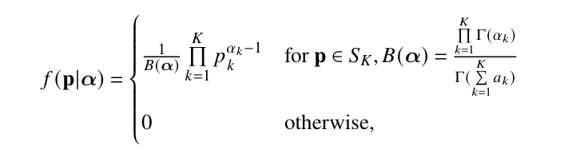
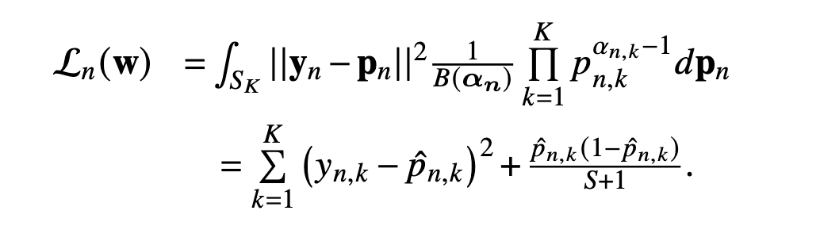
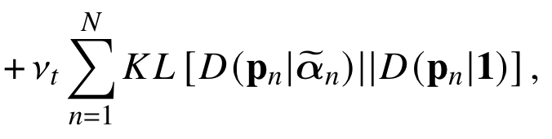
ENN Loss Function
Dirichlet Distribution
Minimize misclassification and uncertainty
Kullback-Leibler Divergence (Eq.11)
Prevent premature convergence to uniform distribution due to misclassified samples.
Maximize the likelihood
Conjugate prior integration, easy in Dir. Distr.
Misclassification Error
KL Div., Regularizer
Uncertainty, Dirichlet Variance

Slide 9
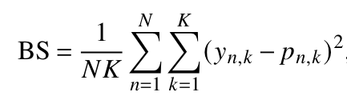
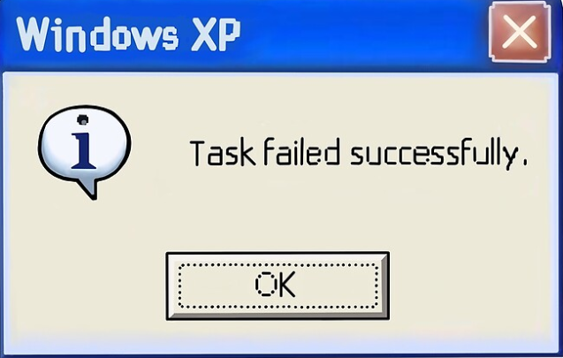
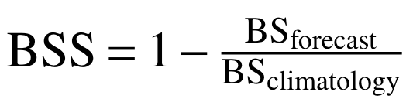

Evaluation Metrics
Brier Score (BS)
Basically feed label into MSE, and trust the process works out, What a BS.
0: Perfect Score, 1: Everything is Wrong (Perfectly Wrong?)
Brier Skill Score (BSS)
Compare BS to Climatology
1: Perfect Score, : Everything is Wrong including climatology

Slide 10
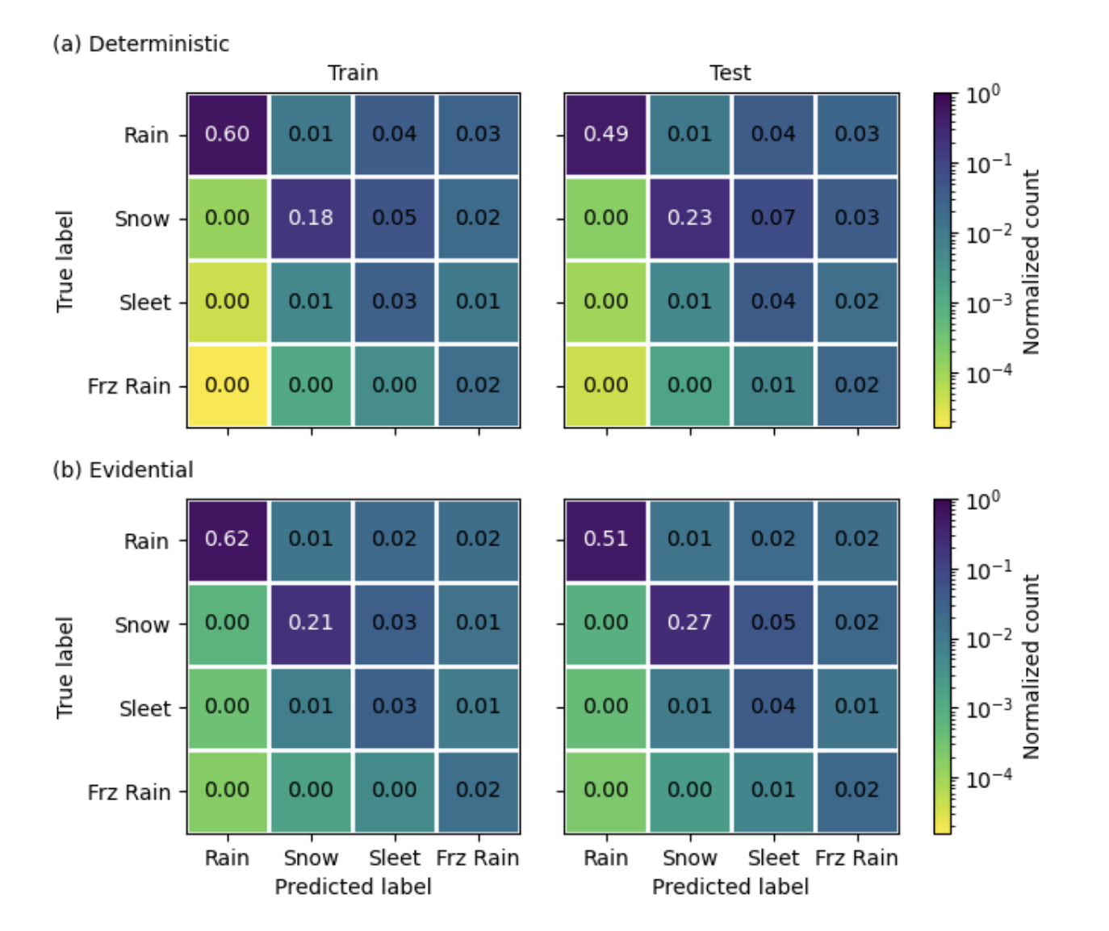
Results: Confusion Matrices (from supplemental of preprint…)
Key points: 1) Deterministic and evidential NNs have comparable performance 2) Very few sleet and freezing rain observations, as expected

Slide 11
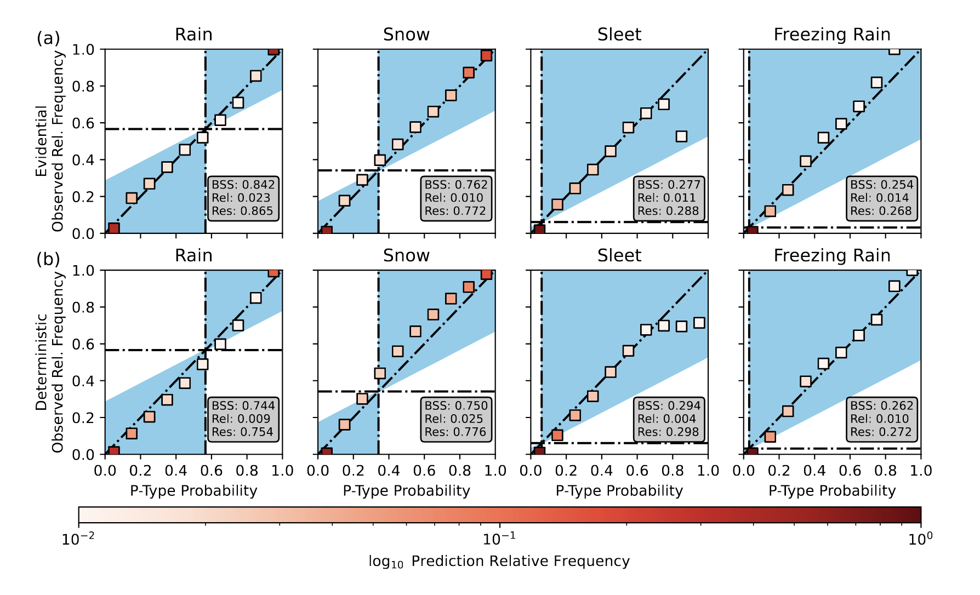
Results

Slide 12
Results: Reliability Diagrams
Perfect Reliability
Reliability = Deviation of predicted <p-type> probability from relative frequency in observations

Slide 13
Results: Reliability Diagrams
For inputs with predicted P(rain)≈0.16, observed P(rain)≈0.19 → model underconfident

Slide 14
Results: Reliability Diagrams
Model overconfident
Model underconfident

Slide 15
Results: Reliability Diagrams
Climatology

Slide 16
Results: Reliability Diagrams
No Resolution Line
Resolution = Average difference of predicted <p-type> probabilities from climatology

Slide 17
Results
Rain and snow: Evidential > Deterministic
Freezing rain and sleet: Evidential < Deterministic

Slide 18
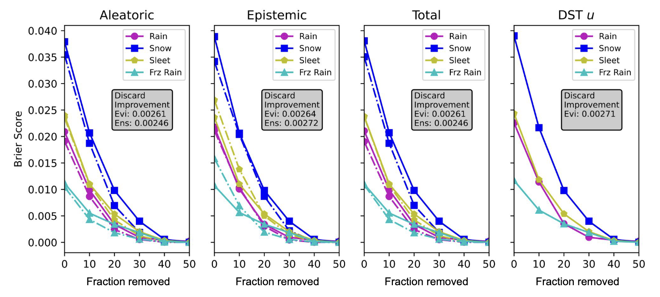
Results
Discard test? 1) Sort test set from least certain to most certain. 2) Iteratively remove N% of least certain data and re-run trained model.
Key points: Test set performance improves as inputs become more “certain”. Similar results for ensemble vs. evidential UQ.

Slide 19
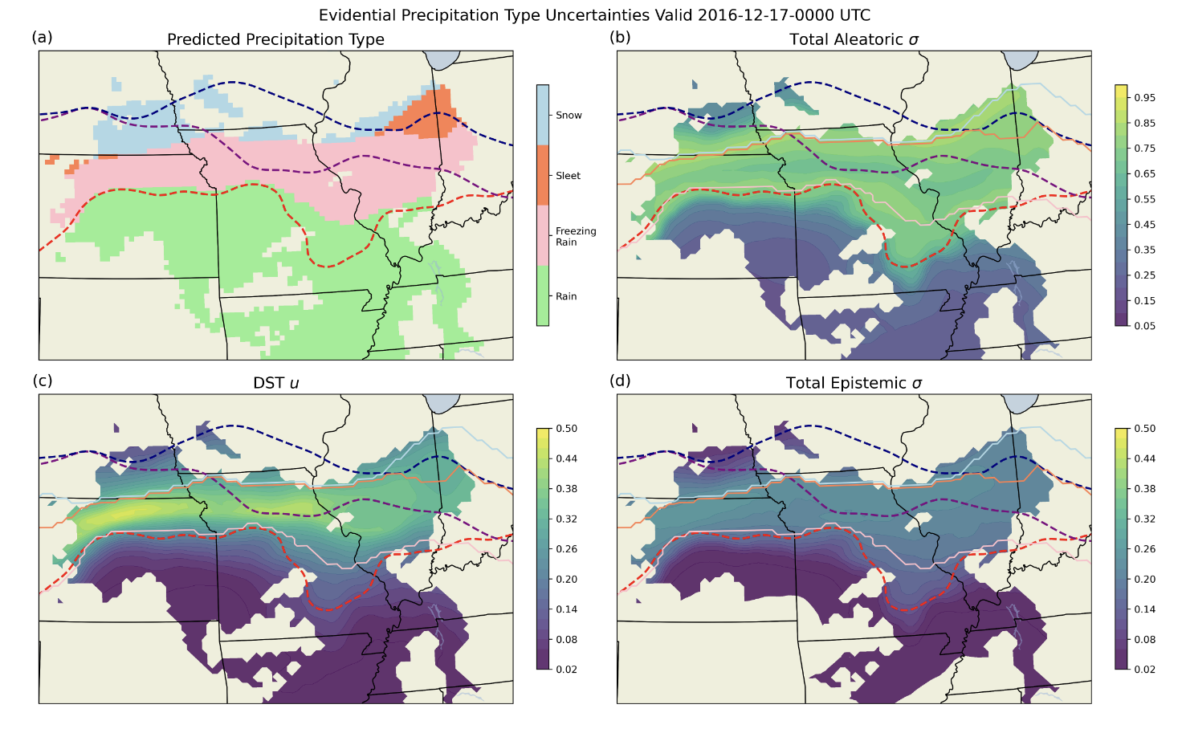
Results
Key points 1) Aleatoric uncertainty high near p-type transition boundaries (data insufficiently constrains the output) 2) Epistemic uncertainty high in freezing rain zone (insufficient # of examples) 3) Aleatoric uncertainty > Epistemic uncertainty

Slide 20
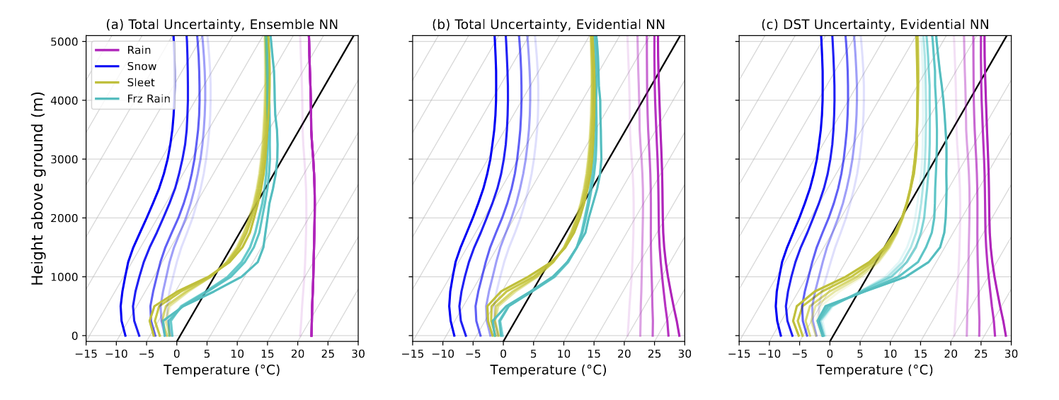
Results
Key point: Uncertainty trend is physically consistent.

Slide 21
Main Points
Evidential NN provides UQ without computational cost ensemble-based NN UQ or physics-based UQ methods
Evidential NN and deterministic NN have comparable p-type prediction performance (accuracy and calibration!)
Aleatoric and epistemic uncertainties are easily computed from evidential NN, and make physical sense!

Slide 22
Discussion Questions
Should reducing one type of uncertainty be prioritized over another (if so, in what scenarios)?
What are some potential applications of uncertainty quantification in your research?
How much utility does this work have for forecasters? How “trustworthy” is this method?
Maybe Combine ENN with other neural networks? Like GAN-CERNN
EVVE, lol

